Slide 1
Visual Dictionary
“If you have a big enough dictionary, just about anything is a word” ~ Dave Barry

Slide 2

Mission…
“Create a shared visual dictionary of terminology used within the system architecture discipline as a reference point”

Slide 3
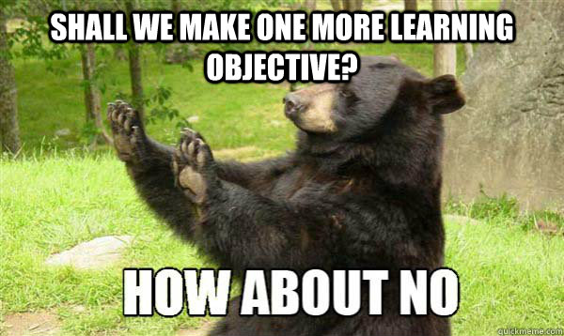
Objectives…
Learning Objectives:
Recognise the main conceptual layers that may exist within an architecture.
Explore one layer per group and elucidate six or so terms within.

Slide 4
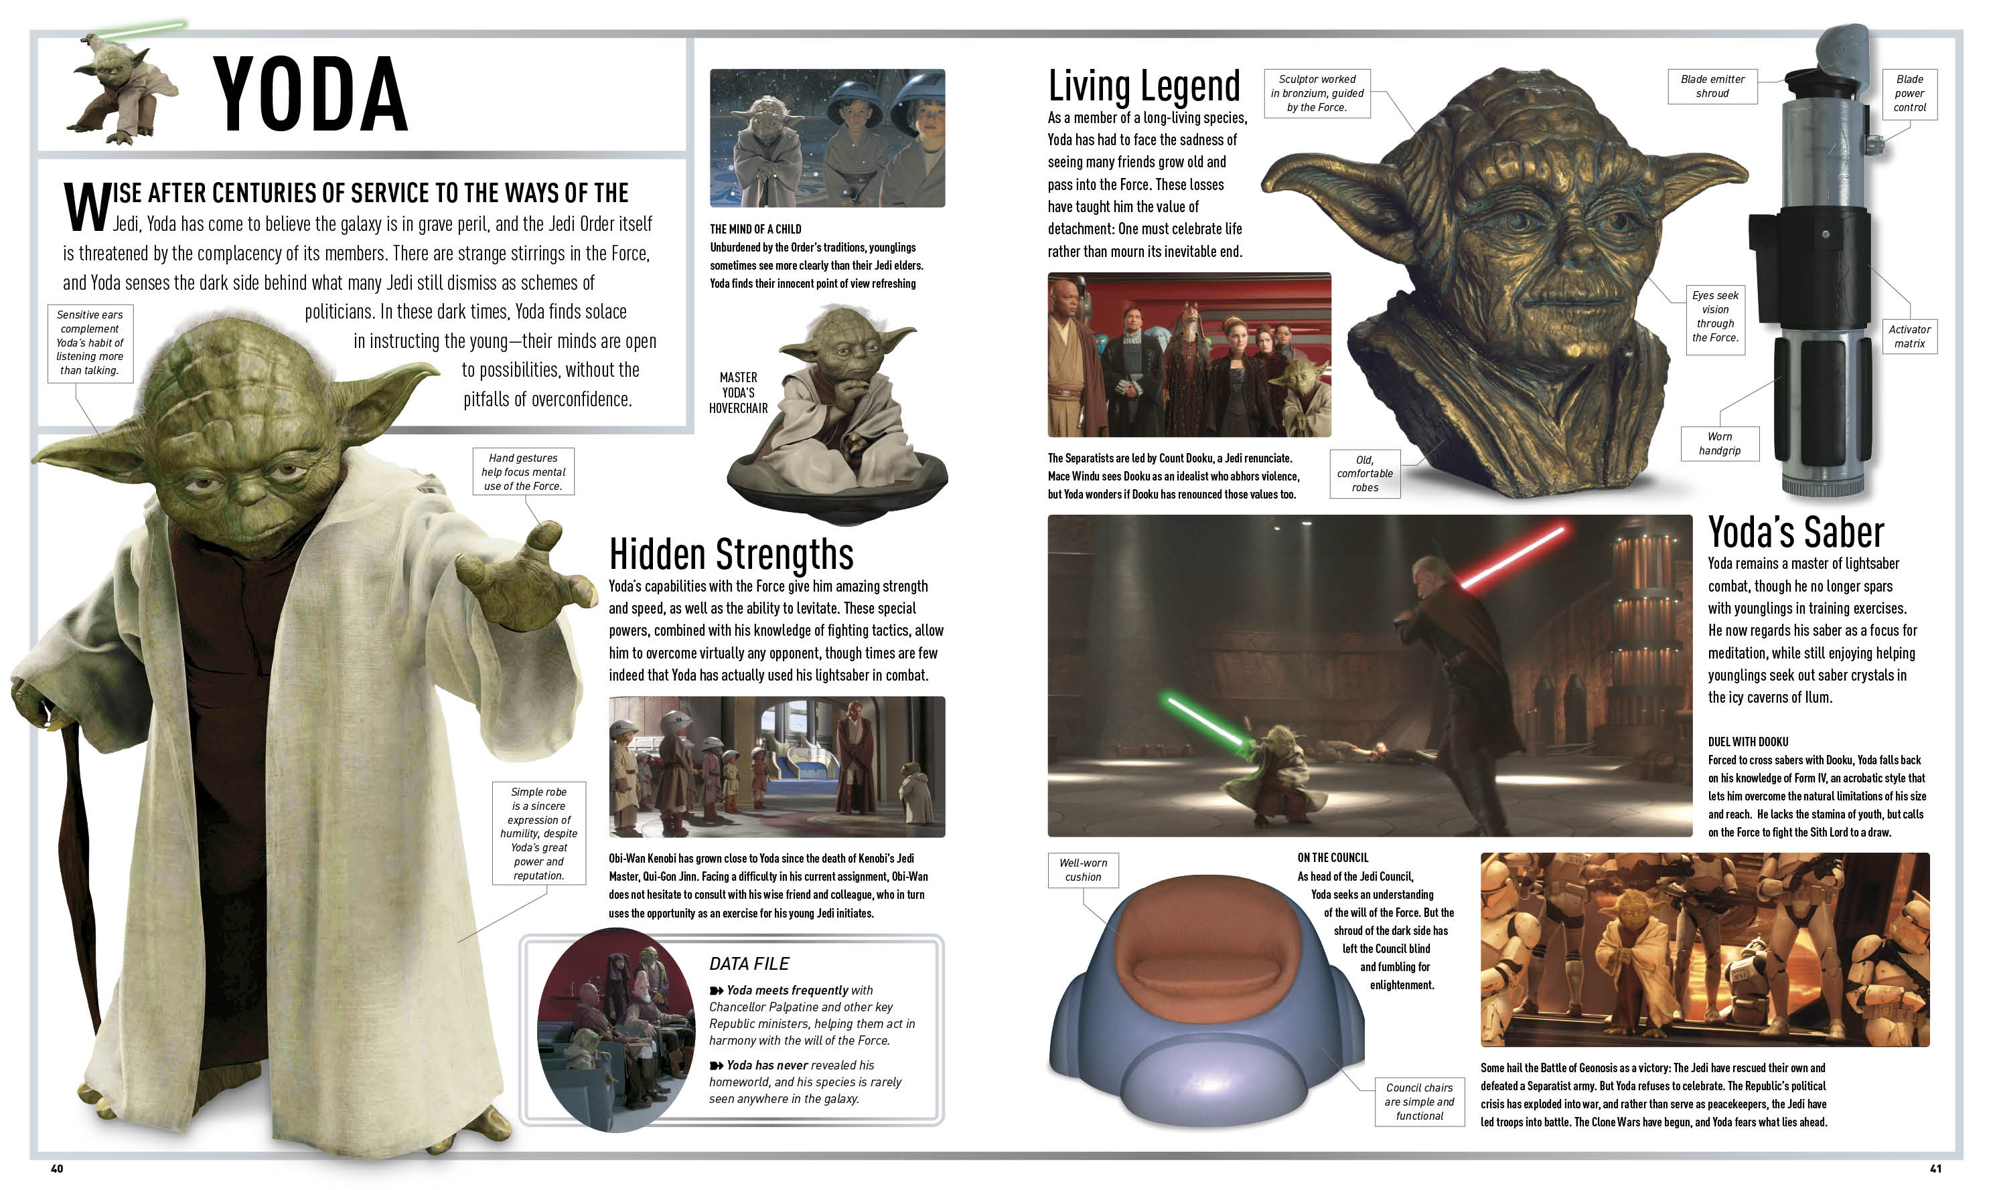
Create a what now…?

Slide 5

Fight!
Groups!
Layers!
Hand-outs!
Examples!
Draw!
Interact!

Slide 6

Summarise…
Say you…
Say Me…

